Slide 1
Progress Meeting 17/04/2020

Slide 2

Progress
Corrected stratified system, removed $\tilde{w}$
State variables -> ($\tilde{v}, \tilde{η}$, $\tilde{b}$)
Implemented the new eigenvalue problem into MATLAB
Looked at papers Lucas, Facchini and Deloncle for boundary conditions

Slide 3

State Variables
$\tilde{v}$
$\tilde{η}$
$\tilde{b}$

Slide 4
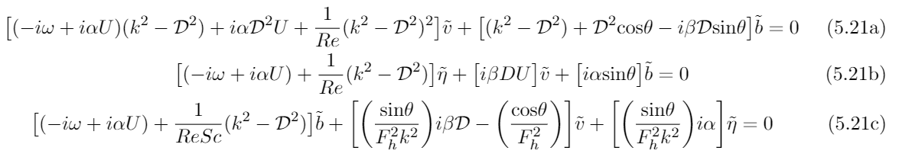

Stratified System - $\tilde{v}$
Stratified Orr-Sommerfeld

Slide 5

Stratified System - $\tilde{η}$
Stratified Squire

Slide 6
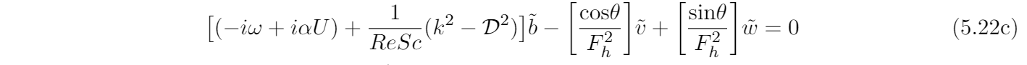

Stratified System - $\tilde{b}$
Density Equation

Slide 7
Stratified System - $\tilde{b}$
Density Equation

Slide 8
Stratified System - $\tilde{b}$
Density Equation

Slide 9
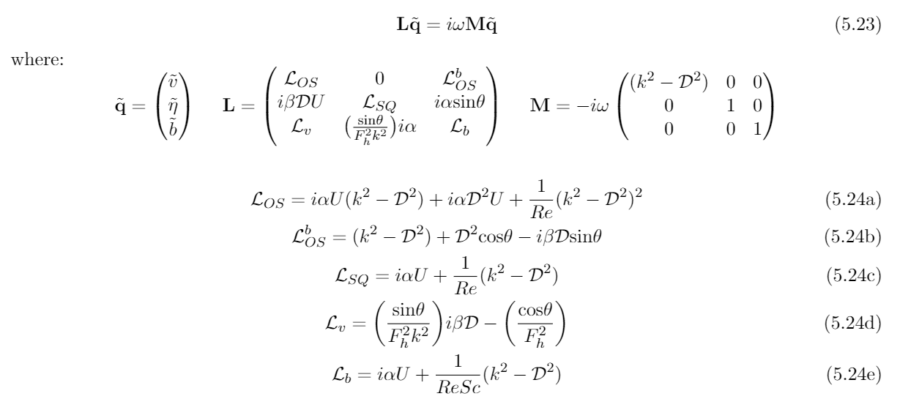
Matrix System

Slide 10

Boundary Conditions
$\tilde{u}$ = 0 - > no-slip
$\tilde{w}$ = 0 - > no-slip
$\tilde{v}$ = 0 - > non-penetrable
$D\tilde{v}$ = 0 - > from continuity equation
$\tilde{η}$ = 0 - > no-flux
$\tilde{b}$???

Slide 11

Boundary Conditions – Lucas
Layer formation and relaminarisation of a spanwise stratified pCf
$D\tilde{b}$ = 0 -> following no-flux condition
In Discussion section:
Tests suggest that applying insulating boundary condition gives very similar results: Dirichlet -> $\tilde{b}$= 0
pCf = plane Couette flow

Slide 12

Boundary Conditions – Facchini
Linear instability of stratified pCf
Linear Stability Analysis
Buoyancy perturbations are set to 0 at the walls: $\tilde{b}$= 0
DNS – validation of Linear Stability Analysis
Newmann: $D\tilde{b}$= 0

Slide 13

Boundary Conditions – Deloncle
3D instability of stratified horizontal shear flows
Base flow has no walls
Perturbations vanish at infinity: $\tilde{b}$= 0

Slide 14

Boundary Conditions
Dirichlet seems reasonable
$\tilde{b}$= 0

Slide 15
Plan For Next Week
Implement boundary conditions
Infrastructure of code:
Q: Would it be useful to produce a plot of the convergence of the e/values with increasing Chebyshev points?
Q: Will I be applying a linear stratification gradient?
Validate code by comparing Facchini

